Slide 1
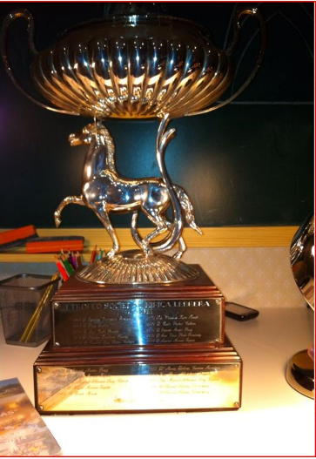
1968

Slide 2
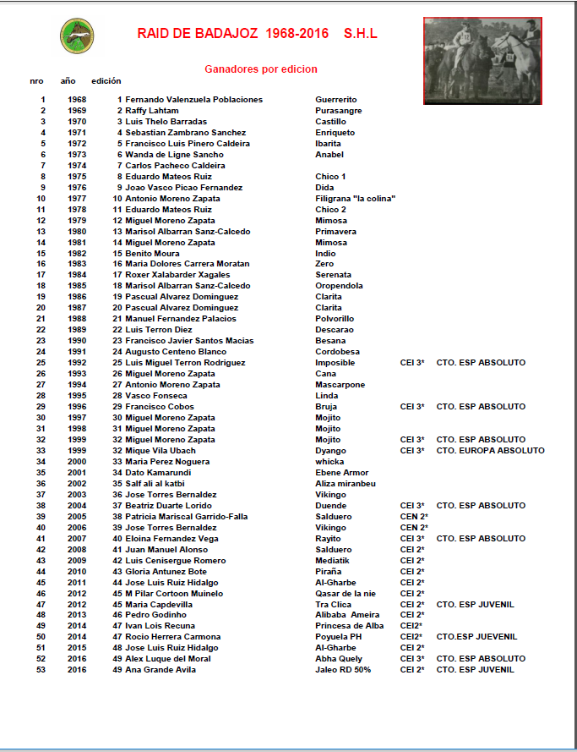
1968

Slide 3
1968

Slide 4
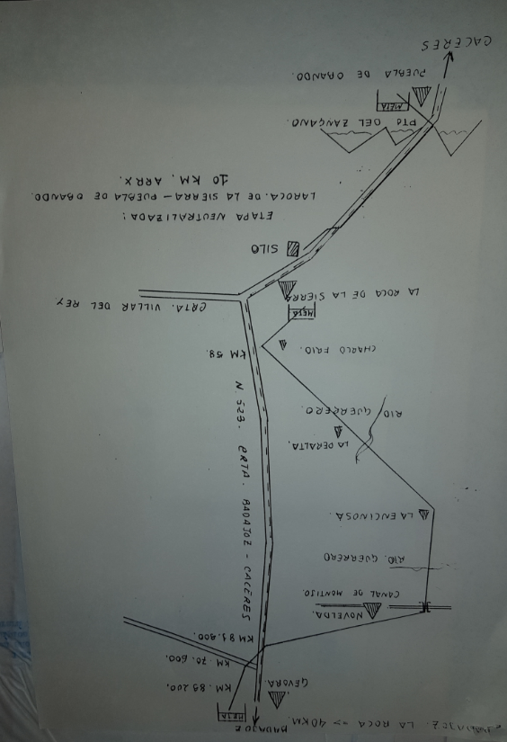
1968

Slide 5
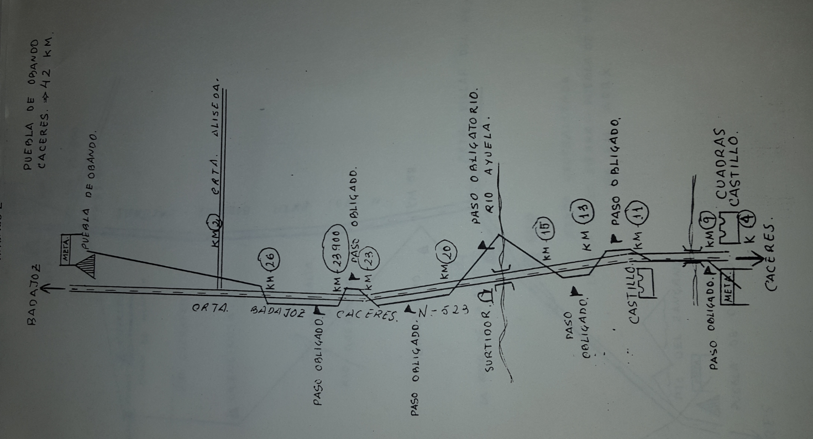
1968

Slide 6
1968
1 | 1968 | 1 | Fernando Valenzuela Poblaciones | Guerrerito

Slide 7
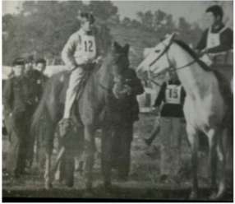
1969
2 | 1969 | 2 | Raffy Lahtam | Purasangre

Slide 8
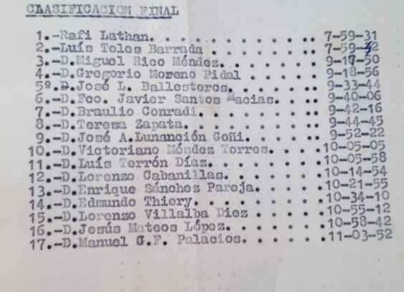
1969
2 | 1969 | 2 | Raffy Lahtam | Purasangre

Slide 9
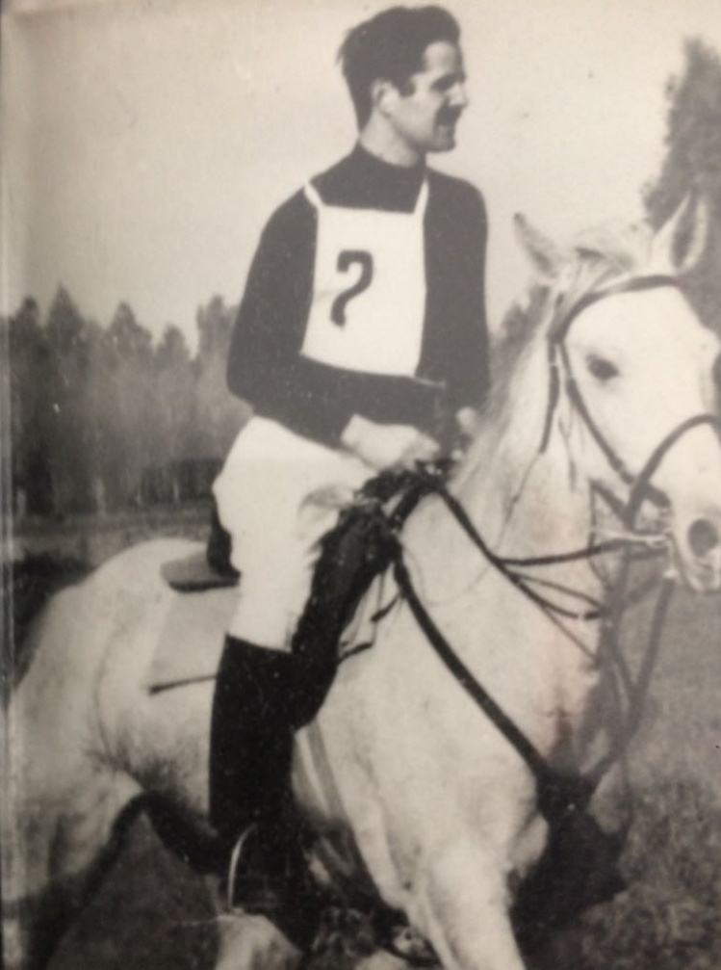
1970
3 | 1970 | 3 | Luis Thelo Barradas | Castillo

Slide 10
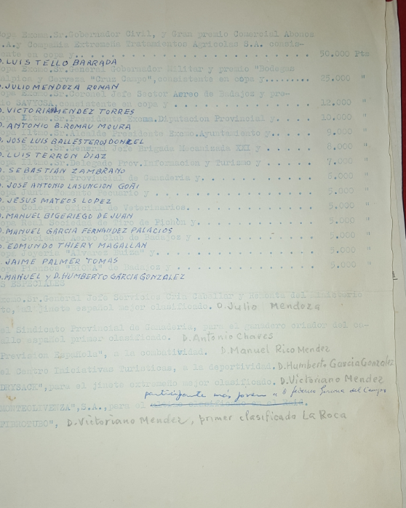
1970
3 | 1970 | 3 | Luis Thelo Barradas | Castillo

Slide 11
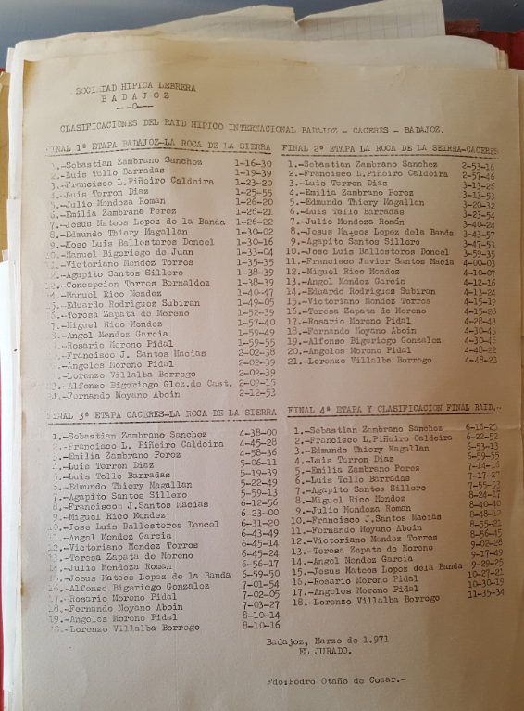
1971
4 | 1971 | 4 | Sebastian Zambrano Sanchez | Enriqueto

Slide 12
1972
5 | 1972 | 5 | Francisco Luis Pinero Caldeira | Ibarita

Slide 13
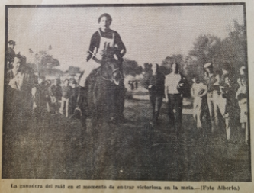
1973
6 | 1973 | 6 | Wanda de Ligne Sancho | Anabel

Slide 14
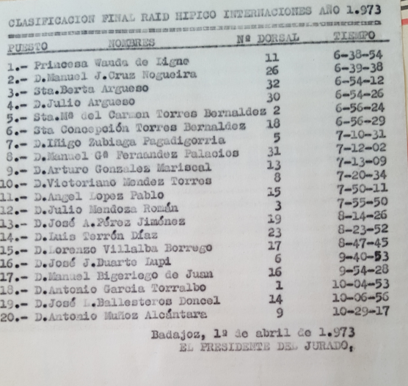
1973
6 | 1973 | 6 | Wanda de Ligne Sancho | Anabel

Slide 15
1974
7 | 1974 | 7 | Carlos Pacheco Caldeira

Slide 16
1975
8 | 1975 | 8 | Eduardo Mateos Ruiz | Chico 1

Slide 17
1976
9 | 1976 | 9 | Joao Vasco Picao Fernandez | Dida

Slide 18
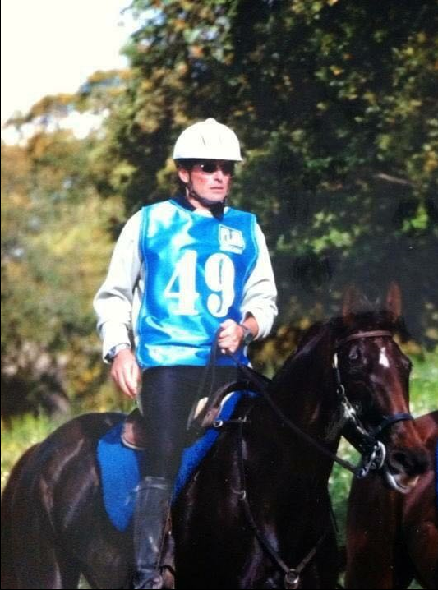
1977
10 | 1977 | 10 | Antonio Moreno Zapata | Filigrana "la colina"

Slide 19
1978
11 | 1978 | 11 | Eduardo Mateos Ruiz | Chico 2

Slide 20
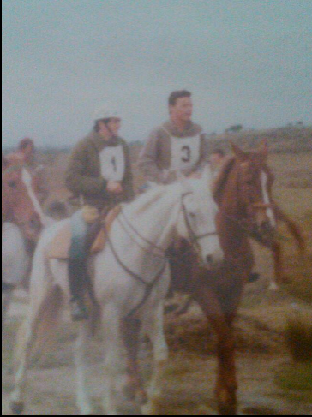
1979
12 | 1979 | 12 | Miguel Moreno Zapata | Mimosa

Slide 21
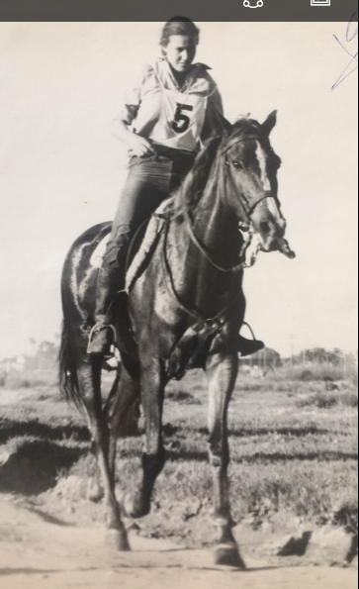
1980
13 | 1980 | 13 | Marisol Albarran Sanz-Calcedo | Primavera

Slide 22
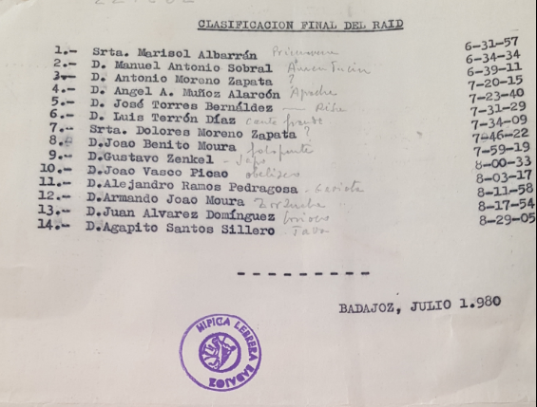
1980
13 | 1980 | 13 | Marisol Albarran Sanz-Calcedo | Primavera

Slide 23
1981
14 | 1981 | 14 | Miguel Moreno Zapata | Mimosa

Slide 24
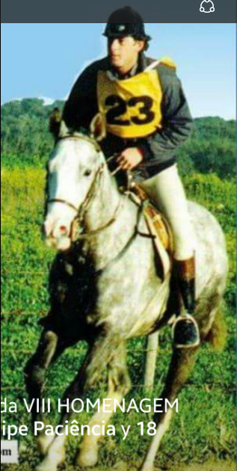
1982
15 | 1982 | 15 | Benito Moura | Indio

Slide 25
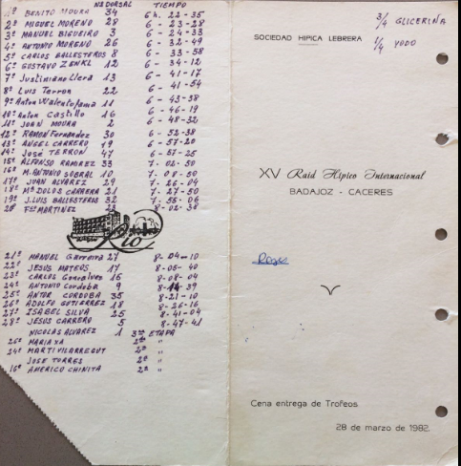
1982
15 | 1982 | 15 | Benito Moura | Indio

Slide 26
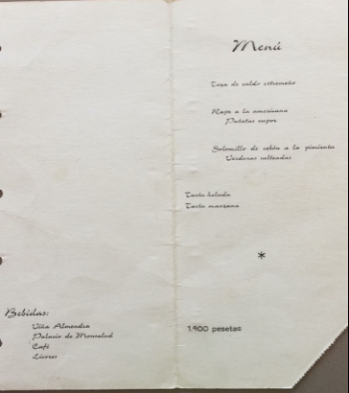
1982
15 | 1982 | 15 | Benito Moura | Indio

Slide 27
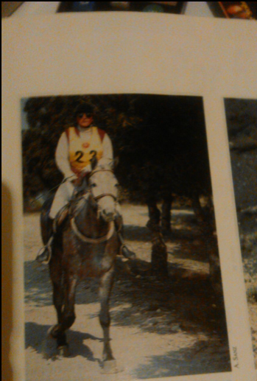
1983
16 | 1983 | 16 | Maria Dolores Carrera Moratan | Zero

Slide 28
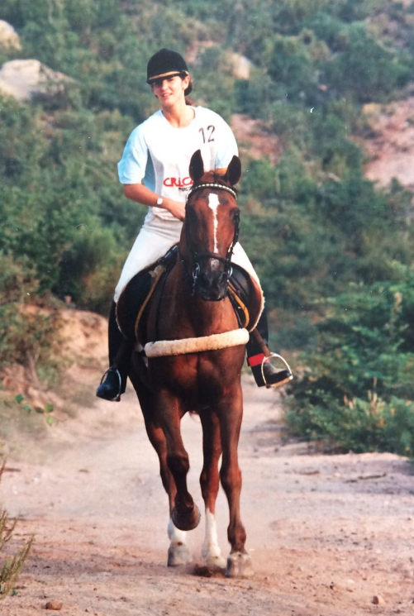
1984
17 | 1984 | 17 | Roxer Xalabarder Xagales | Serenata

Slide 29
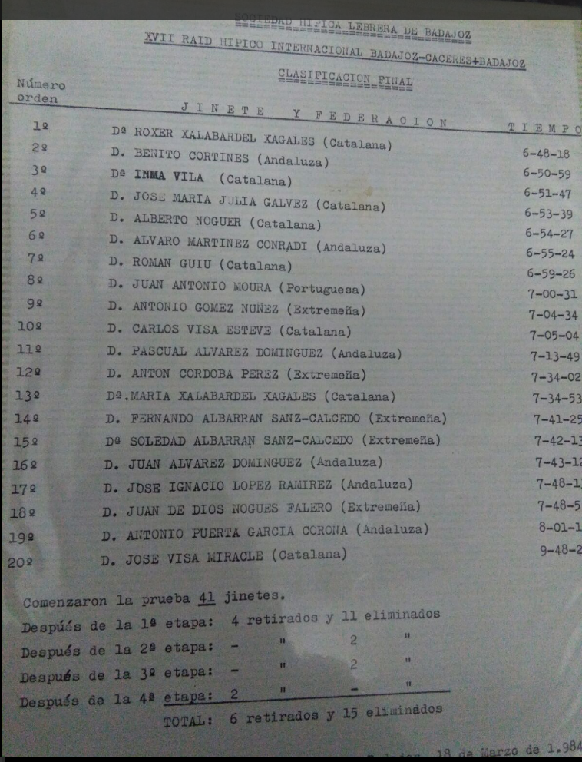
1984
17 | 1984 | 17 | Roxer Xalabarder Xagales | Serenata

Slide 30
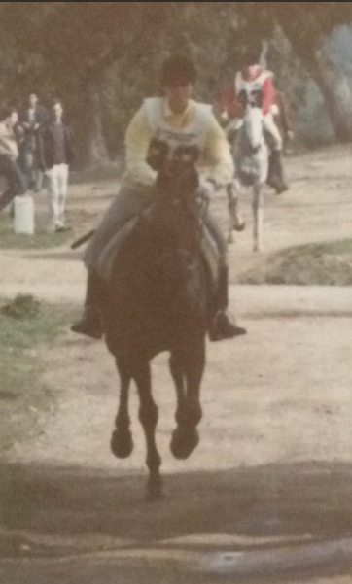
1985
18 | 1985 | 18 | Marisol Albarran Sanz-Calcedo | Oropendola

Slide 31
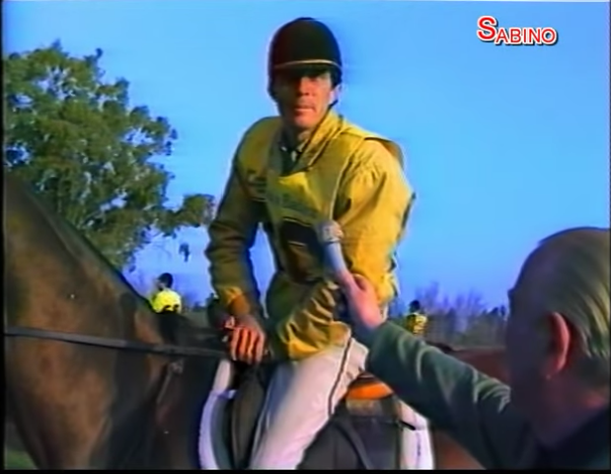
1986
19 | 1986 | 19 | Pascual Alvarez Dominguez | Clarita

Slide 32
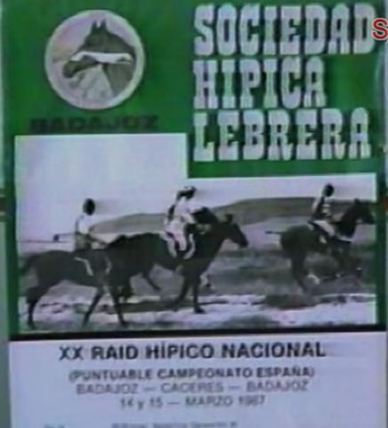
1987

Slide 33
1987
20 | 1987 | 20 | Pascual Alvarez Dominguez | Clarita

Slide 34
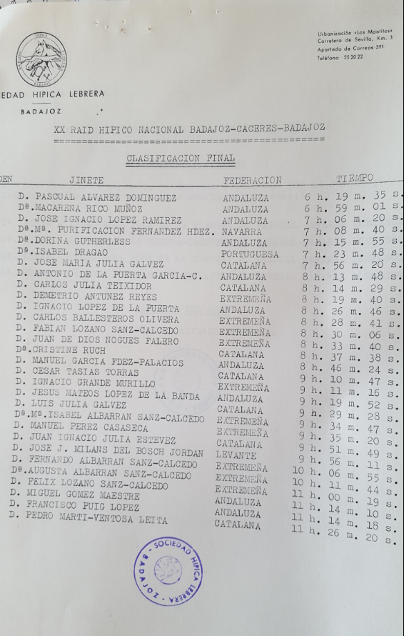
1987
20 | 1987 | 20 | Pascual Alvarez Dominguez | Clarita

Slide 35
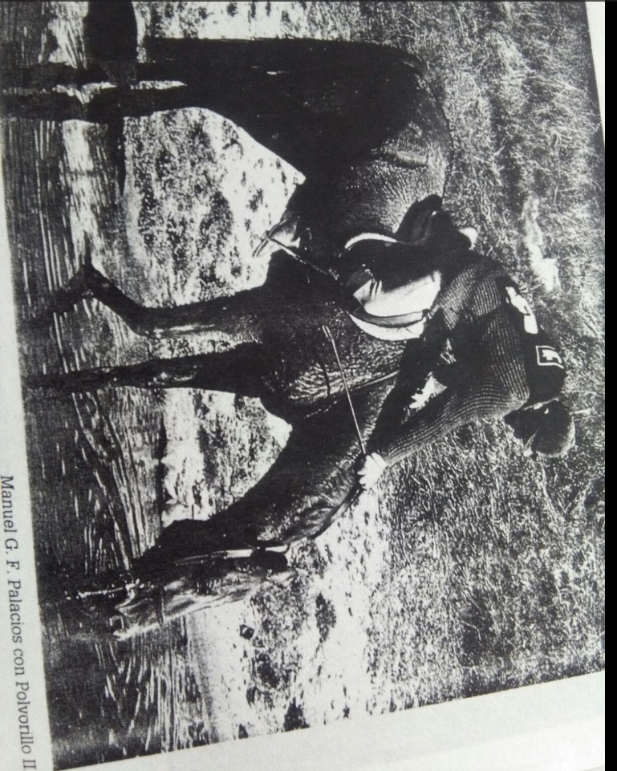
1988
21 | 1988 | 21 | Manuel Fernandez Palacios | Polvorillo

Slide 36
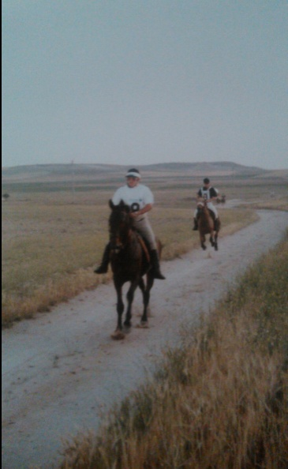
1989
22 | 1989 | 22 | Luis Terron Diez | Descarao

Slide 37
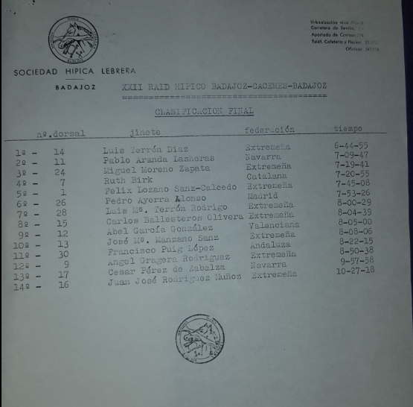
1989
22 | 1989 | 22 | Luis Terron Diez | Descarao

Slide 38
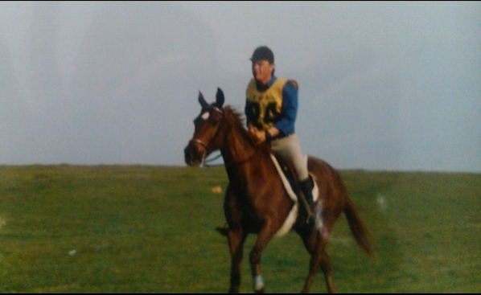
1990
23 | 1990 | 23 | Francisco Javier Santos Macias | Besana

Slide 39
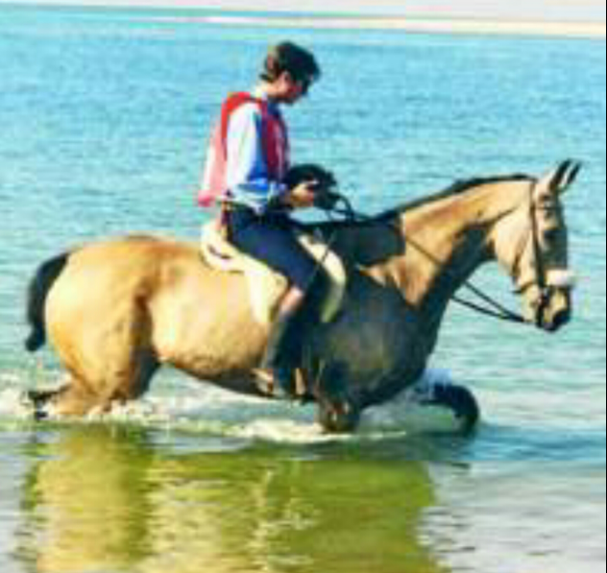
1991
24 | 1991 | 24 | Augusto Centeno Blanco | Cordobesa

Slide 40
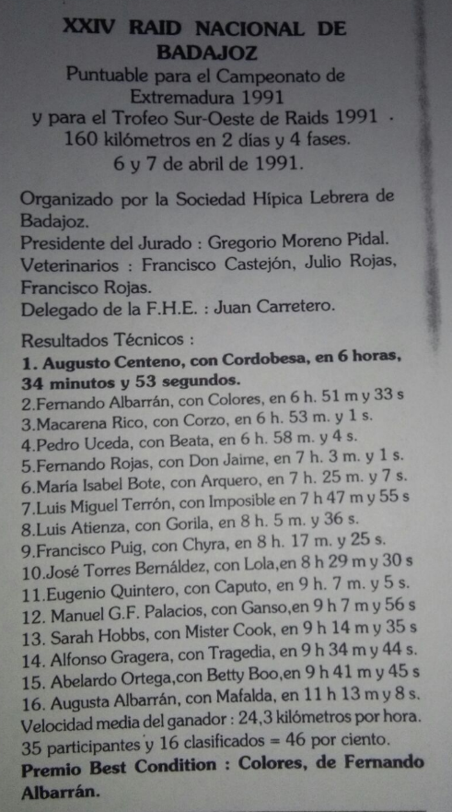
1991
24 | 1991 | 24 | Augusto Centeno Blanco | Cordobesa

Slide 41
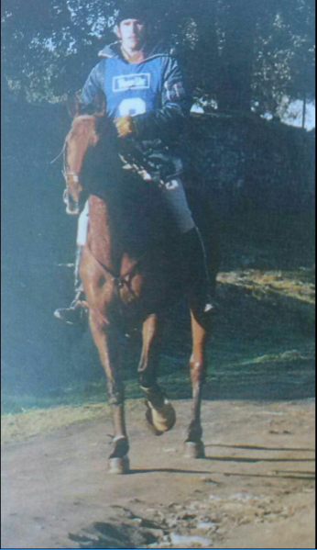
1992
25 | 1992 | 25 | Luis Miguel Terron Rodriguez | Imposible | CEI 3* | CTO. ESP ABSOLUTO

Slide 42
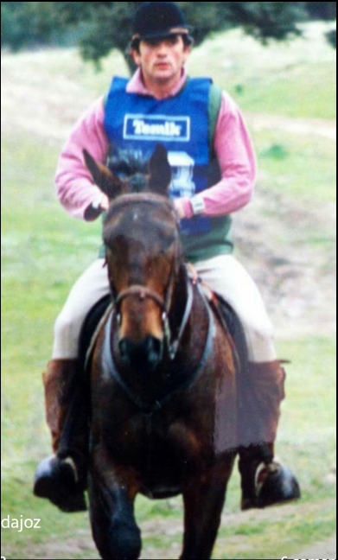
1993
26 | 1993 | 26 | Miguel Moreno Zapata | Cana

Slide 43
1997
30 | 1997 | 30 | Miguel Moreno Zapata | Mojito

Slide 44
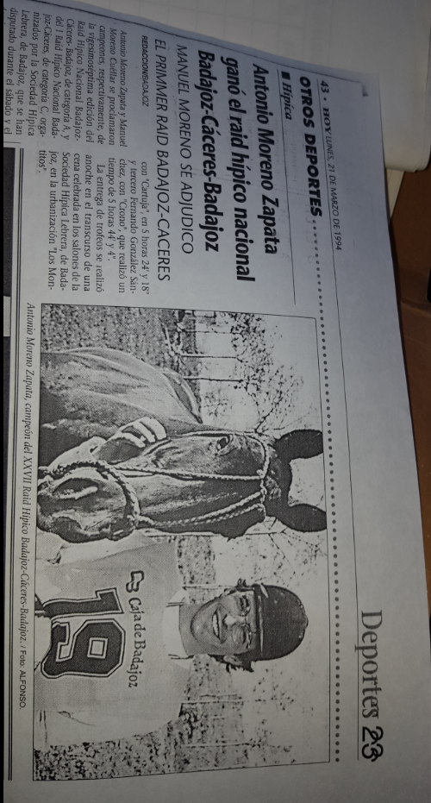
1994
27 | 1994 | 27 | Antonio Moreno Zapata | Mascarpone

Slide 45
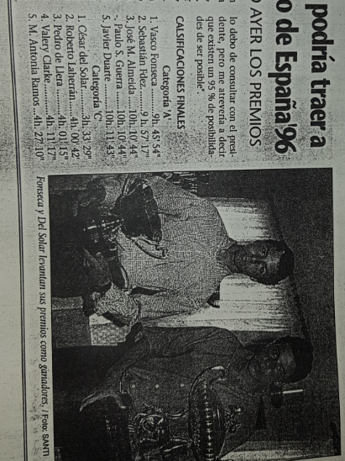
1995
28 | 1995 | 28 | Vasco Fonseca | Linda

Slide 46
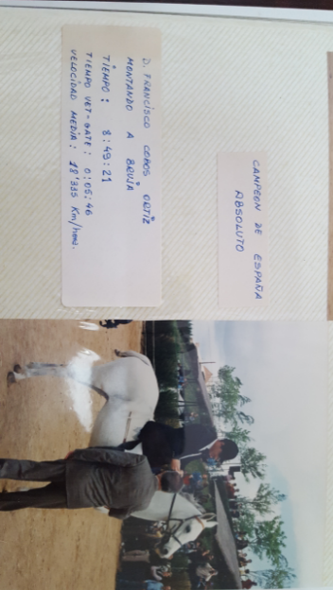
1996
29 | 1996 | 29 | Francisco Cobos | Bruja | CEI 3* | CTO. ESP ABSOLUTO

Slide 47
1997
30 | 1997 | 30 | Miguel Moreno Zapata | Mojito

Slide 48
1998
31 | 1998 | 31 | Miguel Moreno Zapata | Mojito

Slide 49
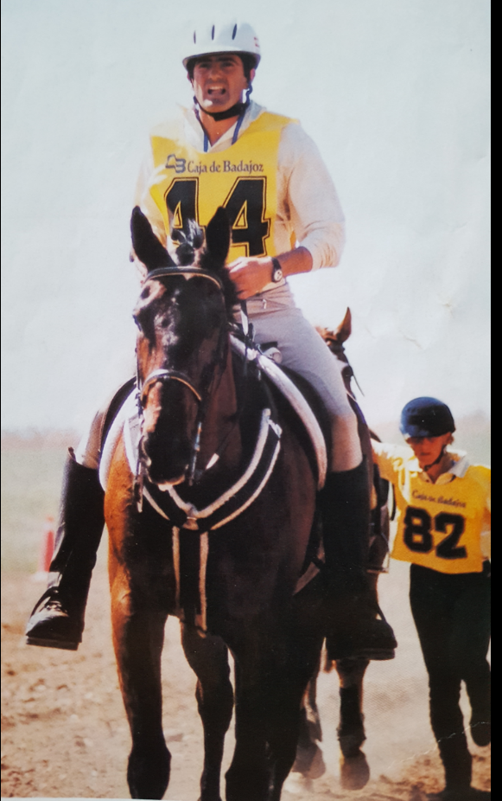
1999
32 | 1999 | 32 | Miguel Moreno Zapata | Mojito | CEI 3* | CTO. ESP ABSOLUTO

Slide 50
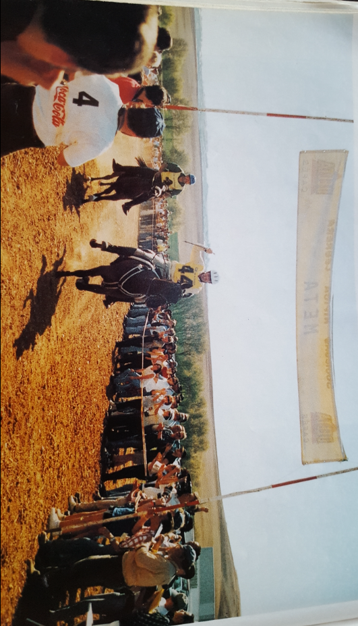
1999
32 | 1999 | 32 | Miguel Moreno Zapata | Mojito | CEI 3* | CTO. ESP ABSOLUTO

Slide 51
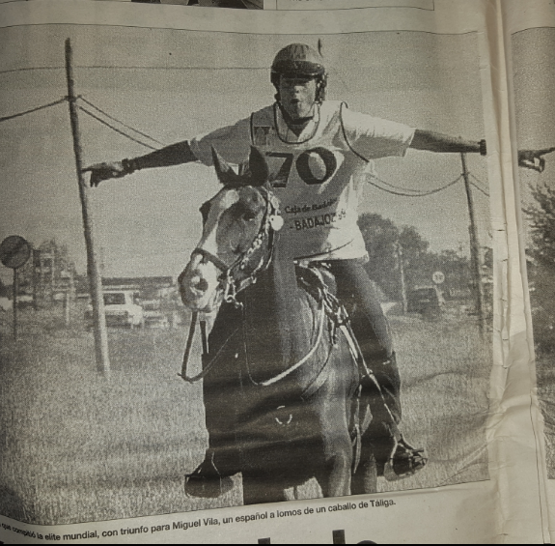
1999
33 | 1999 | 32 | Mique Vila Ubach | Dyango | CEI 3* | CTO. EUROPA ABSOLUTO

Slide 52
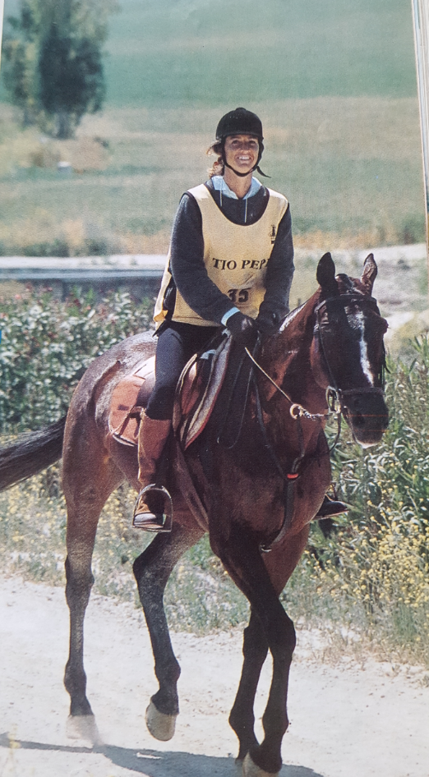
2000
34 | 2000 | 33 | Maria Perez Noguera | whicka

Slide 53
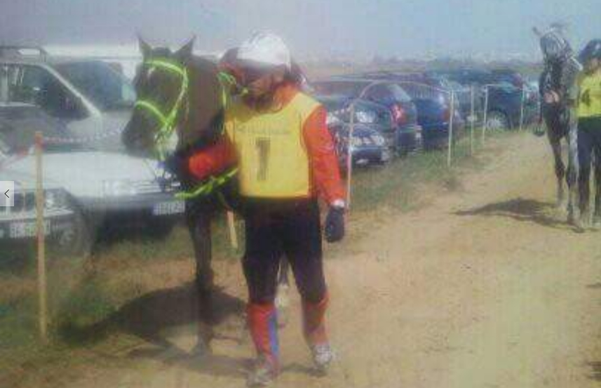
2001
35 | 2001 | 34 | Dato Kamarunddin Abdul Ghani | Degma

Slide 54
2002
36 | 2002 | 35 | Salf ali al katbi | Aliza miranbeu

Slide 55
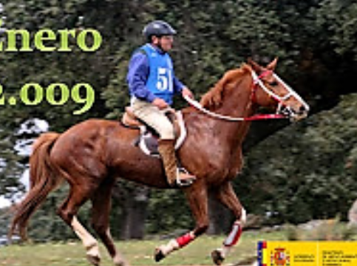
2003
37 | 2003 | 36 | Jose Torres Bernaldez | Vikingo

Slide 56
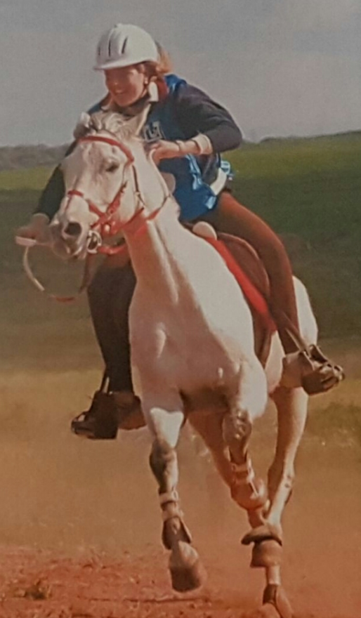
2004
38 | 2004 | 37 | Beatriz Duarte Lorido | Duende | CEI 3* | CTO. ESP ABSOLUTO

Slide 57
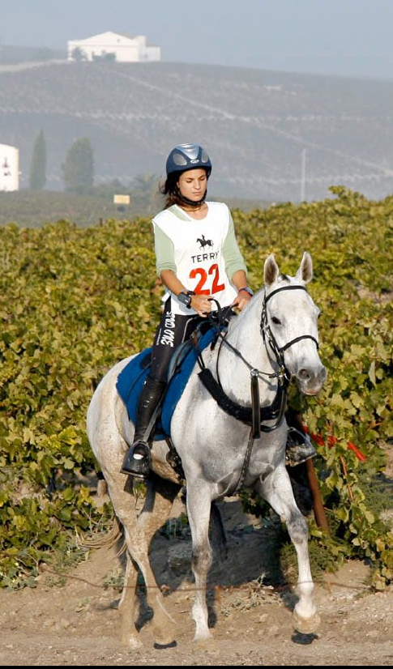
2005
39 | 2005 | 38 | Patricia Mariscal Garrido-Falla | Salduero | CEN 2*

Slide 58
2006
40 | 2006 | 39 | Jose Torres Bernaldez | Vikingo | CEN 2*

Slide 59
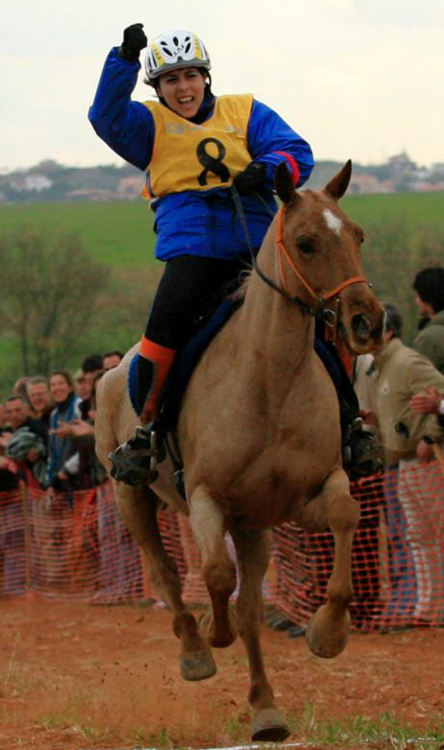
2007
41 | 2007 | 40 | Eloina Fernandez Vega | Rayito | CEI 3* | CTO. ESP ABSOLUTO

Slide 60
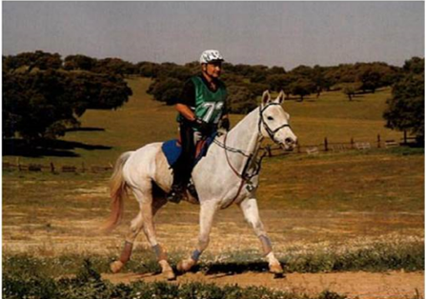
2008
42 | 2008 | 41 | Juan Manuel Alonso | Salduero | CEI 2*

Slide 61
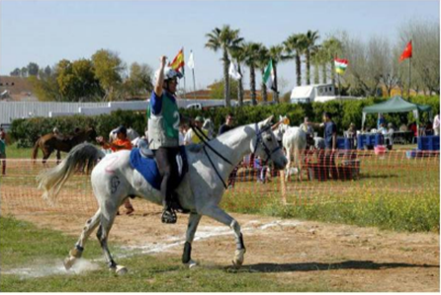
2009
43 | 2009 | 42 | Luis Cenisergue Romero | Mediatik | CEI 2*

Slide 62
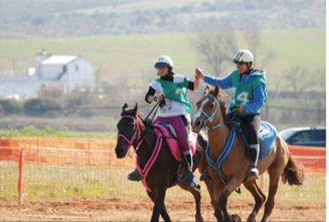
2010
44 | 2010 | 43 | Gloria Antunez Bote | Piraña | CEI 2*

Slide 63
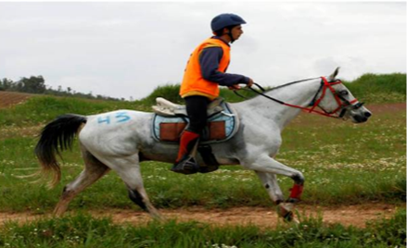
2011
45 | 2011 | 44 | Jose Luis Ruiz Hidalgo | Al-Gharbe | CEI 2*

Slide 64
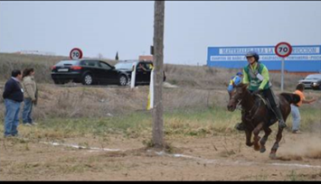
2012
46 | 2012 | 45 | M Pilar Cortoon Muinelo | Qasar de la nie | CEI 2*

Slide 65
2012
47 | 2012 | 45 | Maria Capdevilla | Tra Clica | CEI 2* | CTO. ESP JUVENIL

Slide 66
2013
48 | 2013 | 46 | Pedro Godinho | Alibaba Ameira | CEI 2*

Slide 67
2014
49 | 2014 | 47 | Ivan Lois Recuna | Princesa de Alba | CEI2*

Slide 68
2014
50 | 2014 | 47 | Rocio Herrera Carmona | Poyuela PH | CEI2* | CTO.ESP JUEVENIL

Slide 69
2015
51 | 2015 | 48 | Jose Luis Ruiz Hidalgo | Al-Gharbe | CEI 2*

Slide 70
2016
52 | 2016 | 49 | Alex Luque del Moral | Abha Quely | CEI 3* | CTO. ESP ABSOLUTO

Slide 71
2016
53 | 2016 | 49 | Ana Grande Avila | Jaleo RD 50% | CEI 2* | CTO. ESP JUVENIL

Slide 72
2017
54 | 2017 | 50 | Pedro Godinho | Montalban endurance | CEI 2* 2x70

